Slide 1
Rates Introduction
Mr power

Slide 2
What are rates?
Rates are a relationship between two measurements- the most common rate we use is kilometers per hour
Kilometers is a measure of distance, while hours is a measure of time, so when compared to each other, we can find a measure of speed.
Other rates include
Liters per Minute for flow rates (plumbing)
Kilowatts per Hour (electricians)
Kilojules per Day (Personal Trainer/ Nutritionist)

Slide 3
Brainstorm
How many other rates can you think of?
Where can we use rates?
Are there any rates you use in real life?
Are rates a constant or fixed variable?

Slide 4
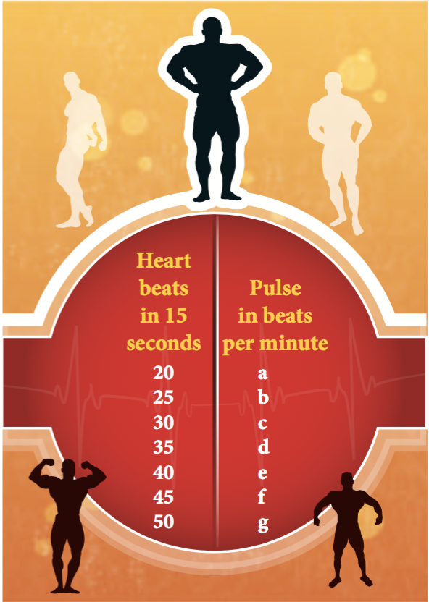
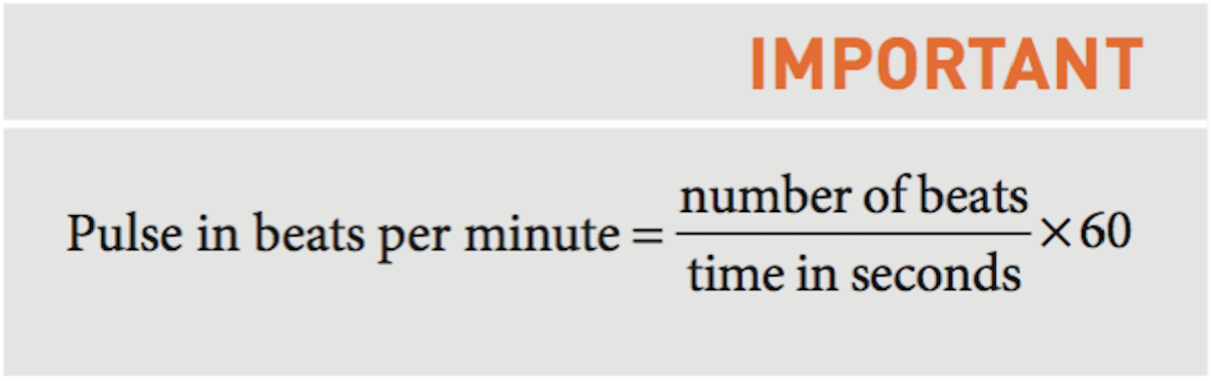
Gym Time:
Convert the following heart beats in 15 seconds to beats per minutes. Use the formula below to assist you.

Slide 5
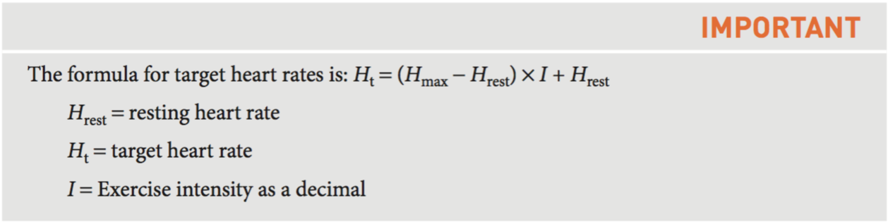
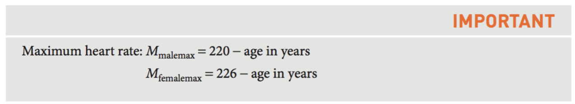
Heart rates:
Heart rates are important for use to know when going to gym, as your heart rate dictates the way your body reacts to the exercise.
Human Respiratory systems have two state: Aerobic and Anaerobic
Aerobic heart rates (70% to 80% of maximum) are good for stamina building
Anaerobic heart rates (80% to 90% or maximum) is good for short burst high intensity recovery
When exercising, we have a target heart rate (H_{t}). This is our maximum heart rate take our resting rate multiplied by the heart rate % as a decimal (60%=0.6, 75% = 0.75 ect) + the resting rate.

Slide 6
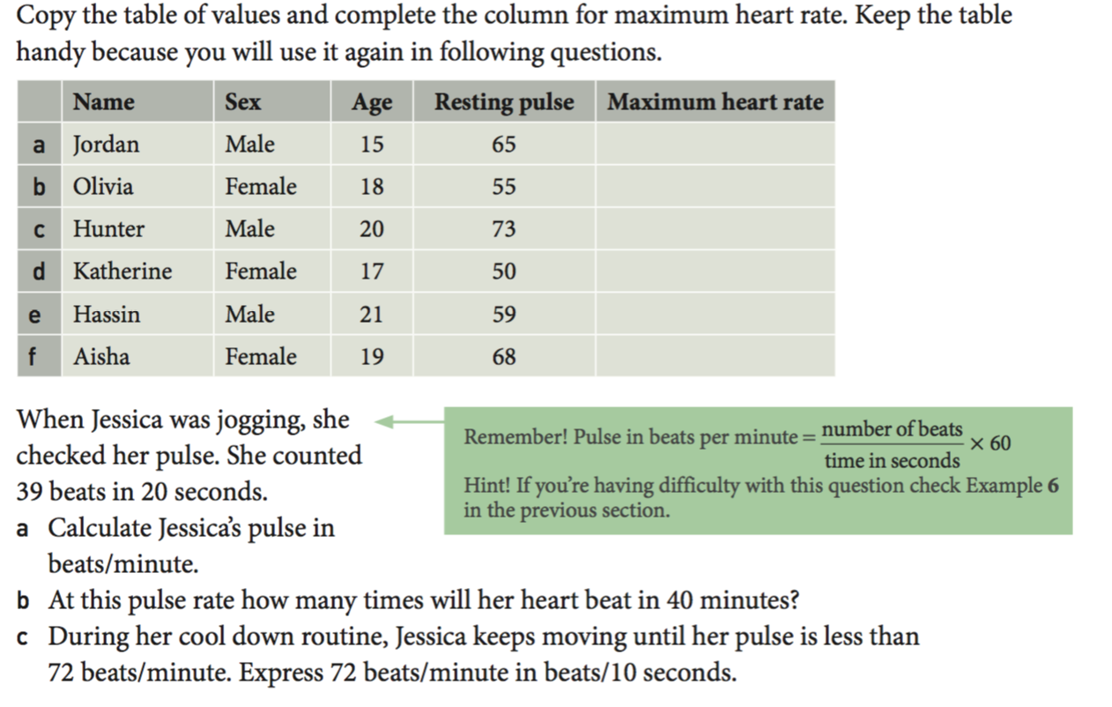
Putting it into practise:
Solve the two questions using your notes

Slide 7
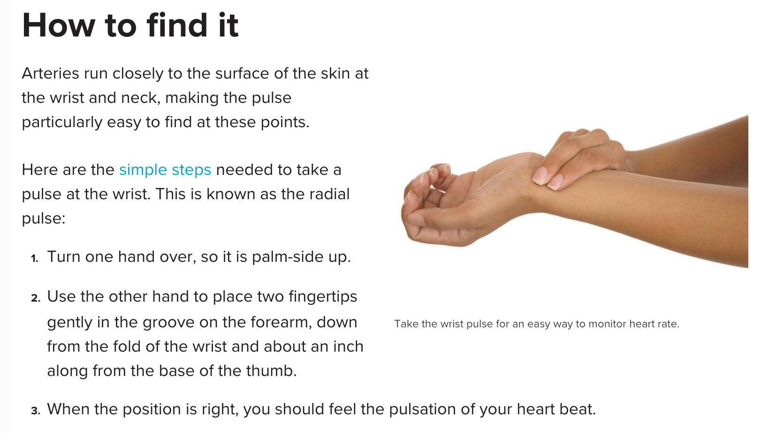
Find your pulse:
Find your pulse and record it for 15 seconds. Make sure you write down this value.

Slide 8
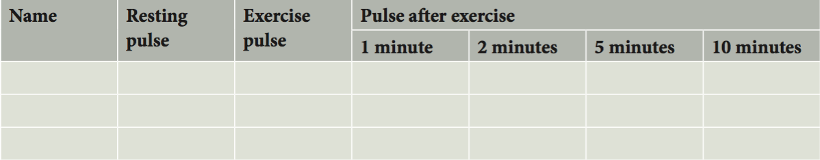
Set up a table
In your notebook, fill in the table with your name and then find two friends to group up with.
Stick in your groups as you walk to the nearest stairs.
Walk up and down the stairs for two minutes, then measure your heart rate. Fill in column two
Record your pulse at every interval after exercise

Slide 9
Scatterplot construction
In your groups, construct a set axes with time on the bottom, and heart rate on the vertical like below.
Using different colours or symbols, plot your heart rates at the minute markers

Slide 10
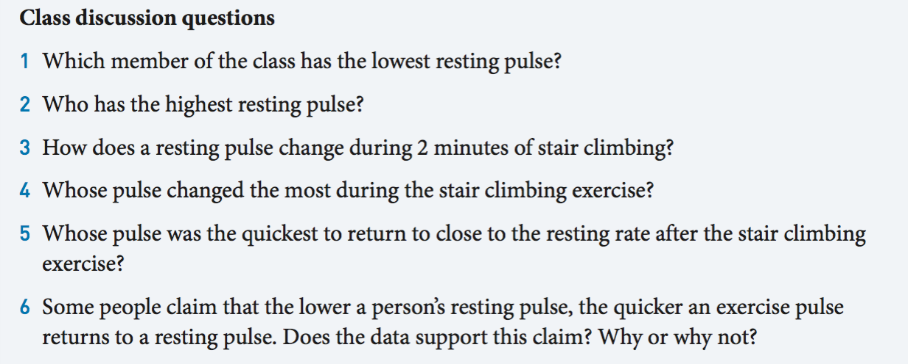
Class discussion

